Slide 1
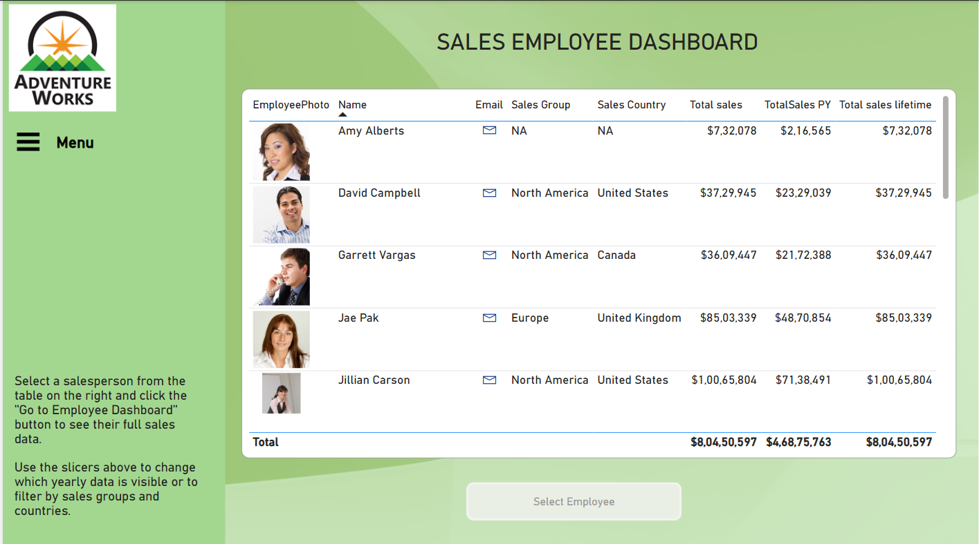

Slide 2
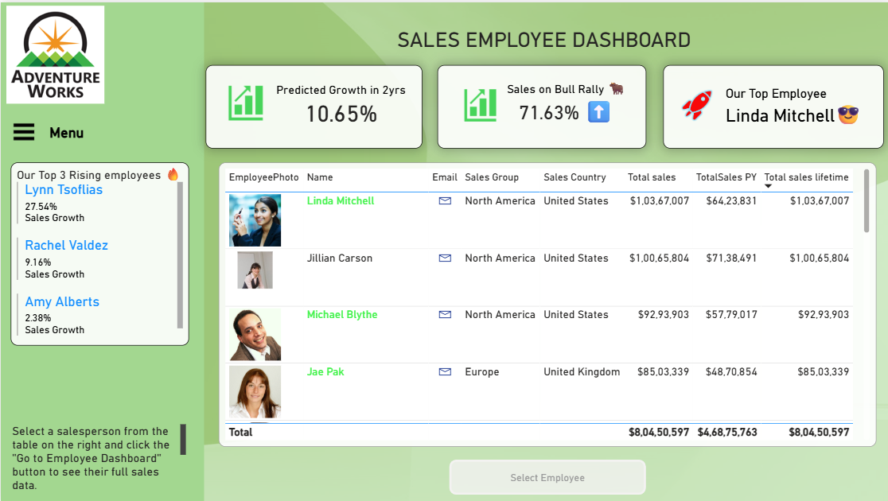

Slide 3
AFFECTIVE SALES: EMOTIONALLY DESIGNED SMART DASHBOARD FOR MULTI-MODEL SALES FORECASTING
GUIDED BY:
Mr. D.Vinod Sir, M.E.CSE, (Ph.D.)
TEAM MEMBERS:
Jai
Santhosh

Slide 4
Objectives:
Predict future sales using XGBoost, Prophet, and LSTM models
Compare model accuracy with MAE, RMSE, and R² Score
Build a smart Power BI dashboard for visualizing forecasts
Support business decisions with interactive and data-driven insights
Create an emotionally intuitive design to engage non-technical users

Slide 5
Abstract:
This project presents an AI-powered Smart Sales Analytics Dashboard that combines Machine Learning (XGBoost, LSTM, Prophet) with Power BI for intelligent sales forecasting. It integrates affective visualization principles to enhance decision-making with emotion-driven and interactive visual storytelling. The system enables businesses to understand past sales, predict future trends, and interpret model performance easily

Slide 6
Introduction:
Businesses generate massive transactional data daily — raw reports aren't enough anymore.
Traditional dashboards lack predictive power and emotional clarity for decision-makers.
Our solution integrates AI-powered models (XGBoost, Prophet, LSTM) into Power BI.
Combines forecasting, KPIs, and storytelling in an interactive dashboard.
Inspired by affective visualization to make insights intuitive, engaging, and actionable.

Slide 7
Project Proposition – Smarter Sales Forecasting with AI
Implement three AI models — XGBoost, Prophet, and LSTM — for robust sales forecasting
Design a dynamic Power BI dashoard to compare predictions with actual sales
Enable data storytelling with KPIs, trendlines, and model performance insights
Integrate intelligent visuals to support faster, data-driven business decisions
Deliver an engaging, emotion-driven experience for non-technical users

Slide 8
LITERATURE REVIEW:
Paper Title | Author(s) | Year | Publisher/Journal | Methodology | Result
BASE PAPER: Affective Visualization Design: Leveraging the Emotional Impact of Data | Xingyu Lan, et al. | 2023 | IEEE Transactions on Visualization and Computer Graphics (TVCG) | Conducted a literature review of 109 papers on affective visualization and categorized emotional impact across 61 projects. | Proposed Affective Visualization Design framework that maps out design space for emotionally engaging dashboards.
Explaining Machine Learning Models in Sales Predictions | M. Bohanec, et al. | 2017 | Expert Systems with Applications | Applied interpretable machine learning to real-world sales data; explained model behavior using decision rules. | Showed how model explainability improves trust and decision-making in sales forecasting using machine learning.
Research on Peak Load Prediction Using Prophet-LSTM | Z. Chen, et al. | 2023 | Sustainability Journal | Combined Prophet and LSTM for hybrid time-series forecasting; tested on energy consumption data. | Demonstrated that Prophet + LSTM is effective for seasonal and sequential pattern prediction. Inspired hybrid models.
Harnessing LSTM and XGBoost for Storm Prediction | A. Frifra, et al. | 2024 | Scientific Reports | Compared LSTM and XGBoost performance in complex weather time-series prediction tasks. | Found that combining deep learning (LSTM) with tree-based ML (XGBoost) improves long-term forecasting accuracy.
Developing Integrated Dashboards Using Power BI | C. T. Gonçalves, et al. | 2023 | Information Journal (MDPI) | Designed enterprise performance dashboards using Power BI; focused on KPIs, filtering, and visuals. | Showcased how interactive dashboards using Power BI drive business decisions and story-based data interpretation.

Slide 9
1. Affective Visualization Design: Leveraging the Emotional Impact of Data Authors: Xingyu Lan, et al. Journal: IEEE Transactions on Visualization and Computer Graphics (TVCG) – 2024
Description:
Reviews 109 research works on emotional elements in data visualization.
Classifies emotional design into categories and shows how it enhances clarity.
Defines a design space to map emotion into dashboards effectively.
Use in Our Project:
This is the base paper that inspired the emotional storytelling in our dashboard.
Guided layout, color use, and the intent behind visual engagement in Power BI.
Model / Evaluation:
No ML model, but highlights visual strategies for stronger data communication.

Slide 10
2. Developing Integrated Performance Dashboards Using Power BI as a Platform Authors: C. T. Gonçalves et al. Journal: Information (Inf.), 2023
Description:
Discusses how Power BI can serve as a unified platform for real-time performance dashboards.
Provides methods for creating multi-layered dashboards using enterprise data.
Emphasizes linking KPIs, metrics, and narrative in visuals.
Use in Our Project:
Helped in planning the layout and layering KPIs in Power BI.
Justified our choice of Power BI for its drill-downs, interactivity, and story mode.
Model / Evaluation:
Focus on dashboard architecture, not ML; emphasized KPI integration and real-time metrics.

Slide 11
3. Explaining Machine Learning Models in Sales Predictions Authors: M. Bohanec et al. Journal: Expert Systems With Applications, 2017
Description:
Analyzes how sales forecasting models work and can be explained in business use cases.
Focuses on model interpretability — including decision trees and ensemble learning.
Explains how black-box ML can be translated into business language.
Use in Our Project:
Supported our choice of XGBoost for explainability and accuracy.
Inspired scorecards and visual explanation of model metrics like MAE, RMSE, R².
Model / Evaluation:
Highlights tree-based ML (XGBoost), discusses feature importance and business impact.

Slide 12
4. Research on Peak Load Prediction Using Prophet-LSTM Model Authors: Z. Chen et al. Journal: Sustainability, 2023
Description:
Proposes hybrid time-series modeling using Prophet + LSTM for electricity demand.
Validates Prophet’s trend-seasonality decomposition and LSTM’s memory power.
Shows comparative evaluation with MAE, RMSE.
Use in Our Project:
Validated our use of Prophet for trend and LSTM for sequence prediction.
Inspired evaluation flow and monthly sales forecasting format.
Model / Evaluation:
MAE and RMSE used as key metrics.
Combines traditional (Prophet) and deep learning (LSTM) for sequence prediction.

Slide 13
5. Harnessing LSTM and XGBoost Algorithms for Prediction Authors: A. Frifra et al. Journal: Scientific Reports (Nature), 2024
Description:
Uses XGBoost and LSTM for time-based predictions in weather and disaster events.
Compares ML and deep learning models in noisy real-world datasets.
Shows how combining statistical models with deep learning improves accuracy.
Use in Our Project:
Influenced our decision to combine three models for different strengths.
Motivated us to use XGBoost for accuracy, LSTM for sequential patterns, and Prophet for time-trend smoothing.
Model / Evaluation:
Strong RMSE-based comparison across models.
Supported using multiple models for better prediction reliability.

Slide 14
SYSTEM ARCHITECTURE:
Raw Data Layer
Sales Data (.CSV or SQL)
Data Preprocessing Layer
Python (Pandas, Numpy) -Cleaning, feature engineering
Modeling Layer
XGBoost Model
Prophet Model
LSTM Model
Evaluation Layer
MAE, RMSE, MAPE – Model performance Comparison
Visualization Layer
Power BI Dashboard (Forecast view, Model switcher, KPIs)
Fig: System Architecture Diagram

Slide 15
Architecture work flow:
AI Forecasting Models
XGBoost, Prophet, LSTM
Model Outputs
Predicted Sales CSVs
Dashboard Layers
Forecast View, Insights, Sentiment (NLP)
KPI Evaluation
MAE / RMSE / R² Comparison
Sales Data Source
AdventureWorks DW
Calendar Integration
Month-Year Standardization
Data Preparation
Cleaning & Feature Engineering
Power BI Loading
Actual + Predicted Data

Slide 16
Architecture Diagram For XGBoost:
DATA SET
Sample data
Description : XGBoost is a powerful machine learning algorithm known for high accuracy and fast training. It works well with structured, tabular data like sales transactions. In this project, it captured the complex relationship between features like income, region, product, and sales amount, making it the most accurate forecasting model among the three.
_ _ _ _ _ _ _ _ _ _ _ _ _ _ _ _ _ _ _ _ _ _ _ _ _ _ _ _ _ _ _ _ _ _ _ _ _ _ _ _ _ _ _ _
D1
D2
….
Dn
Construction of decision - trees
Tree 1
Tree 2
Tree 3
….
Result_1
Result_2
Result_n
_ _ _ _ _ _ _ _ _ _ _ _ _ _ _ _ _ _ _ _ _ _ _ _ _ _ _ _ _ _ _ _ _ _ _ _ _ _ _ _ _ _ _ _
Sum of Results
Final output

Slide 17
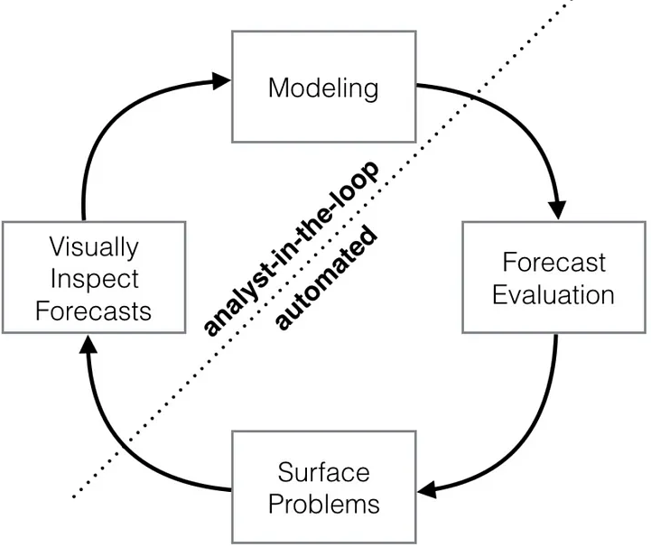
Architecture Diagram For Prophet:
Description : Prophet is a time series forecasting model developed by Facebook, designed for handling trends and seasonality. It works well with sales data that changes over time in patterns. This model provides interpretable forecasts and is ideal for business scenarios with clear calendar effects and holiday impacts.

Slide 18
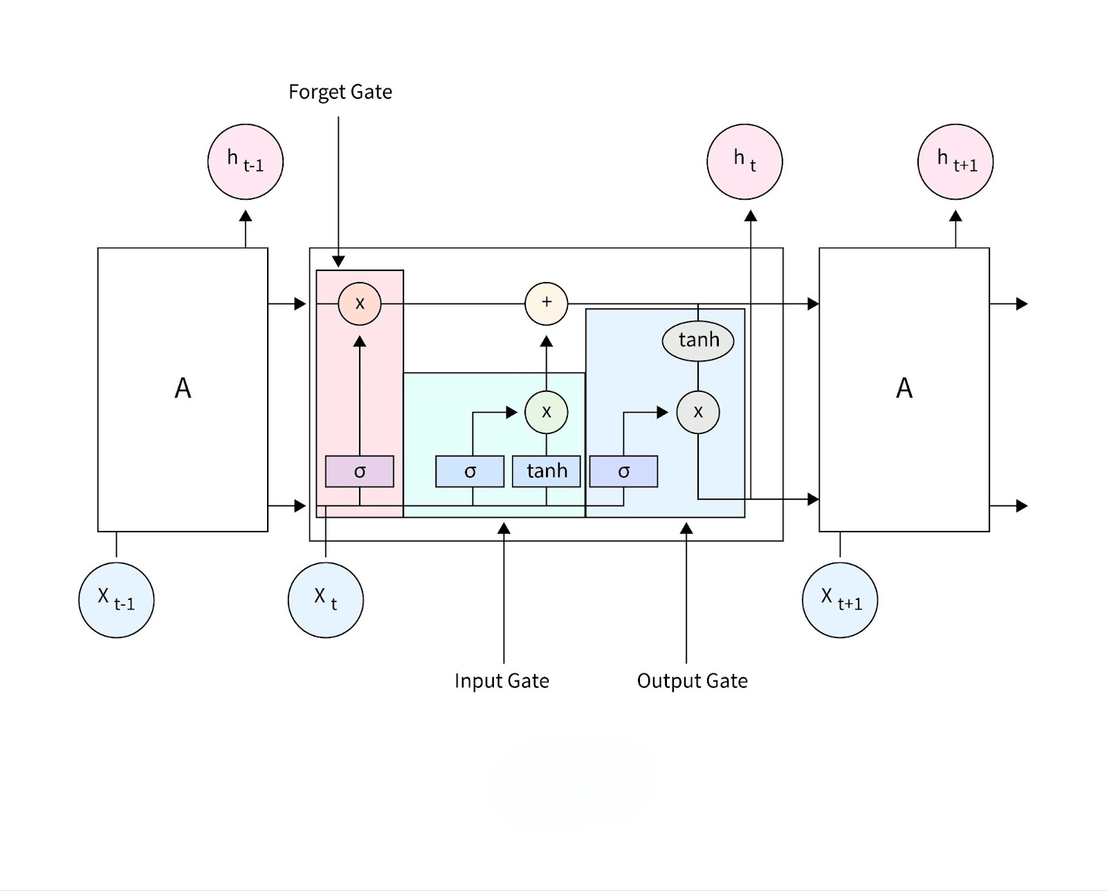
Architecture Diagram For LSTM:
Description : LSTM (LongShort-Term Memory) is a type of deep learning model specialized for sequential data. It learns from previous time steps to forecast future sales, making it useful for capturing long-term dependencies and hidden patterns in historical sales trends.

Slide 19
Power bi development Flow:
Power Query Data Transformation and manipulation
Power BI Dimensional Modelling
Measures Creation
Power BI Dashboard Development
Source data in warehouse
Report Documentation
Data Refresh and Scheduling
Monitoring and Governance
SQL Server Data Extraction

Slide 20
Module’s description:
Module 1: Data Collection
Module 2: Data Preprocessing
Module 3: ML Model – XGBoost
Module 4: ML Model – Prophet
Module 5: ML Model – LSTM
Module 6 : Power BI Dashboard

Slide 21
Module 1: Data Collection
Sourced sales data from AdventureWorks DW 2022
Imported into SQL Server and explored key tables: FactInternetSales, DimDate, DimProduct, etc.
Extracted required fields like SalesAmount, OrderDate, ProductLine, and Region
Exported as combined dataset: cleaned_sales_data.csv

Slide 22
Module 2: Data Preprocessing
Cleaned and merged multiple tables using SQL
Created useful time features like OrderDate, YearMonth, CalendarYear, and EnglishMonthName
Removed irrelevant or redundant columns (e.g., ProductKey, CustomerKey)
Applied One-Hot Encoding for categorical fields
Scaled numeric features with StandardScaler
Final output used: cleaned_sales_data.csv

Slide 23
Module 3: ML Model – XGBoost (Extreme gradient bossting tree)
Supervised regression using XGBRegressor
Target Variable: SalesAmount
Applied Train-Test split with 80-20 ratio
Evaluated using MAE, RMSE, and R² Score
Predictions exported to: XGBoost_sales_forecast.csv
Best for structured/tabular data forecasting

Slide 24
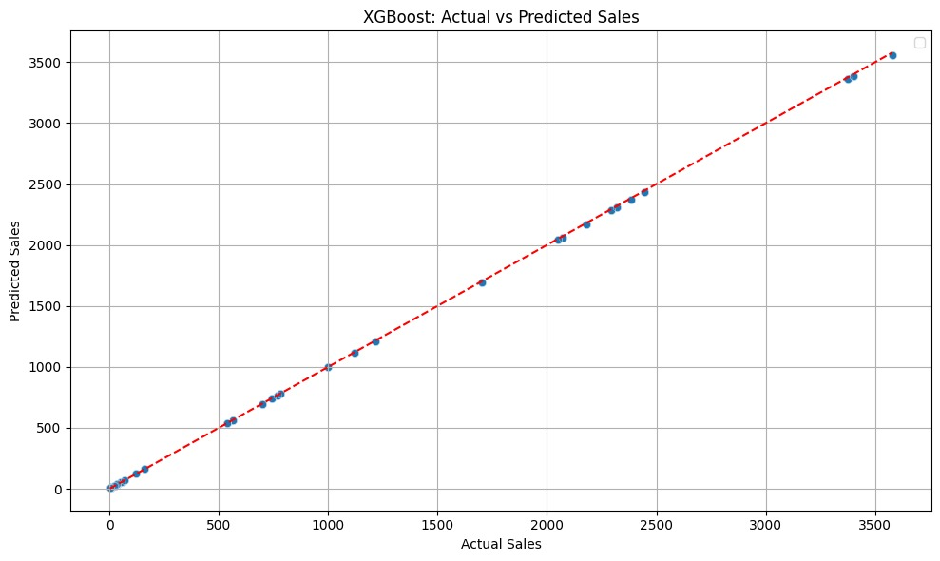

Slide 25
Module 4: ML Model – Prophet
Time-series forecasting using Facebook Prophet
Input: Monthly aggregated SalesAmount
Forecasted sales for next 24 months
Automatically handled seasonality and trend components
Predictions exported to: prophet_sales_forecast.csv
Best for business-level trend insights

Slide 26
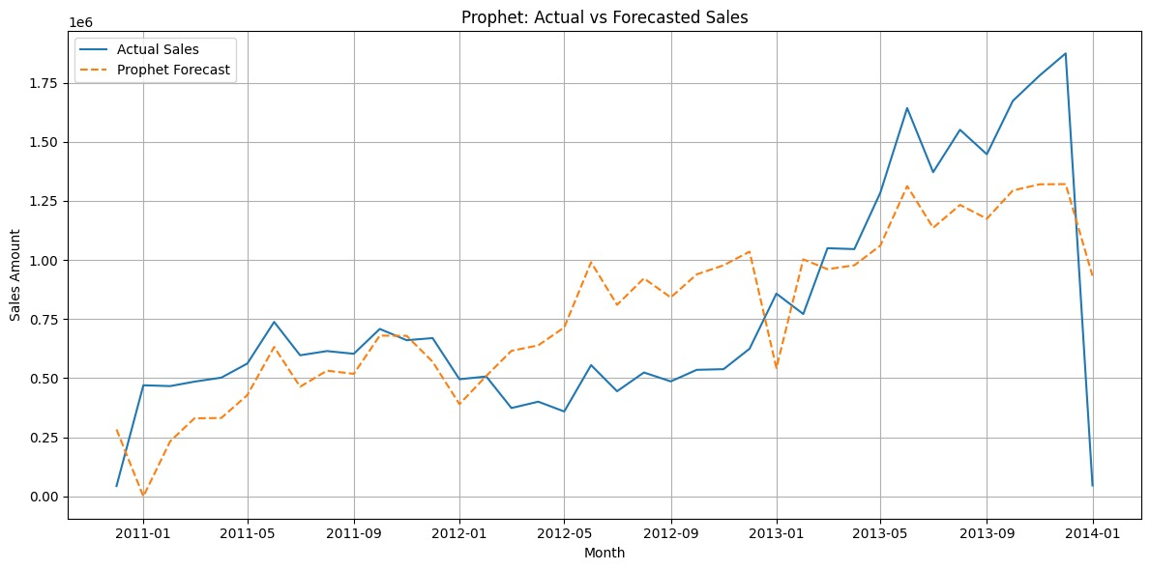

Slide 27
Module 5: dl Model – LSTM
Sequential model for time-based forecasting
Used 12 months look-back window to predict next sales
Trained deep LSTM network with MinMaxScaler
Forecasted 2 years (24 months) ahead
Predictions exported to: lstm_sales_forecast.csv
Best for capturing long-term patterns in sequences

Slide 28
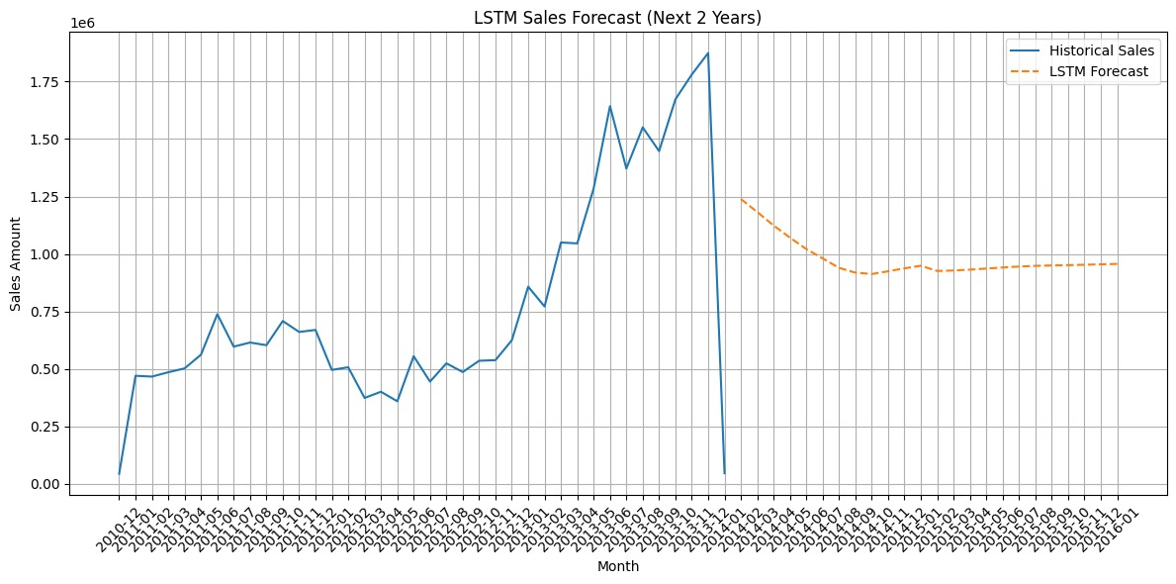
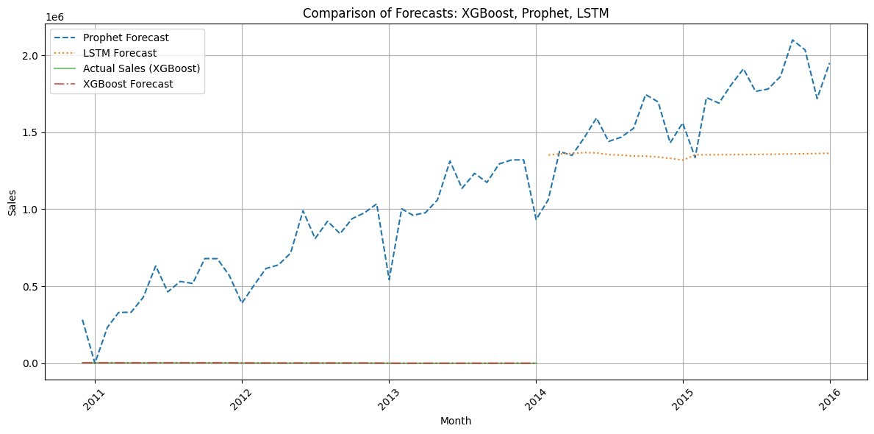

Slide 29
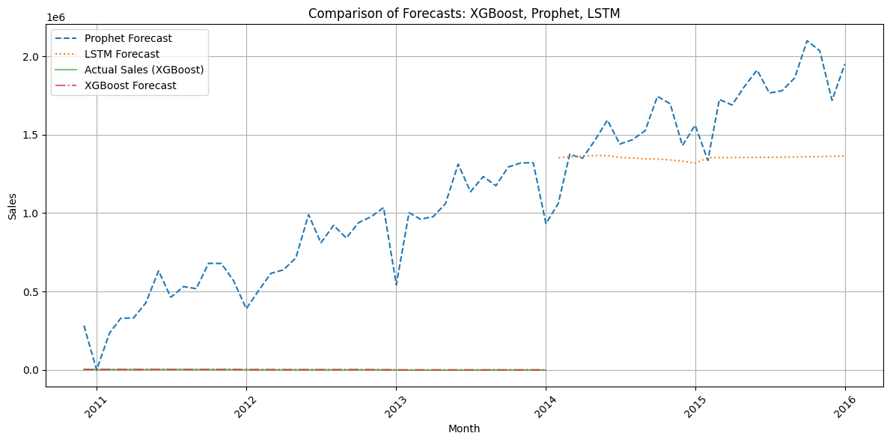
Forecast Comparison: XGBoost vs Prophet vs LSTM
All three models trained on the same sales dataset
Forecasts visualized from 2011–2016
Prophet captures strong trends and seasonal patterns
LSTM provides stable sequential predictions
XGBoost follows actual sales curve with linear precision
Enables visual comparison of model accuracy and behavior

Slide 30
Module 6: Power BI Dashboard
Built an interactive multi-page dashboard in Power BI.
Integrated actual and predicted sales from XGBoost, Prophet, and LSTM.
Used KPIs, slicers, and model-wise line charts for clear comparison.
Unified date columns to align forecasts with actual sales.
Pages include: Forecast Comparison, Scoreboard, and Sales Trends.

Slide 31
Module 6: Power BI Dashboard
Built dynamic dashboard using Power BI
Visuals include line charts, KPIs, slicers for year/model
Unified Month column from all models to compare with actual
Pages include: Forecast Comparison, Model Metrics, Sales Explorer
Data from all CSVs: XGBoost, Prophet, LSTM, Actual Sales

Slide 32
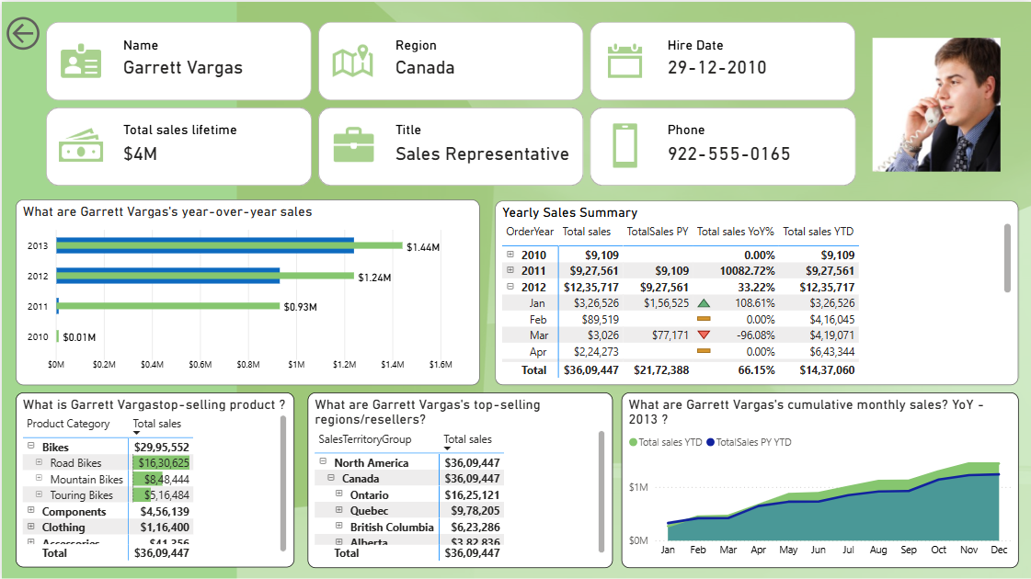

Slide 33
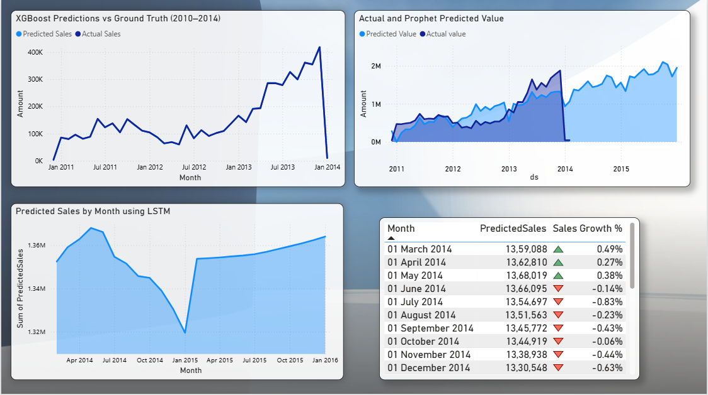

Slide 34
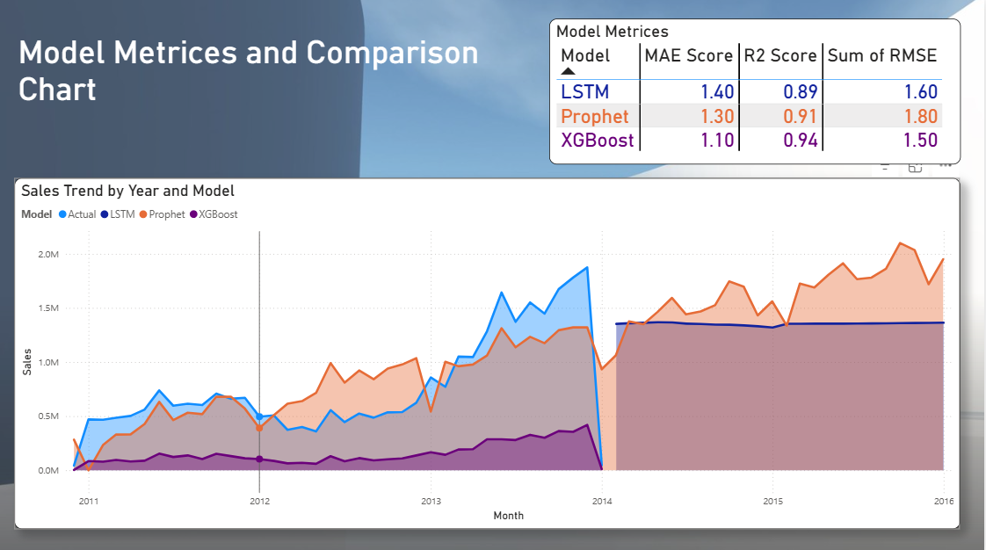

Slide 35
Future Enhancements
To make the system even more powerful and practical in real-world business settings, several enhancements are planned:
Enable Real-Time Forecasting Connect the dashboard to live sales data streams for up-to-date predictions and insights.
Integrate Conversational AI Add a ChatGPT-powered assistant to answer sales-related questions in natural language.
Analyze Customer Sentiment Use Natural Language Processing (NLP) to extract valuable insights from customer reviews and feedback.
Employee-Wise Forecasting Predict employee performance, growth trends, and impact on sales using HR + sales data.

Slide 36
Conclusion:
Implemented three AI models — XGBoost, Prophet, LSTM — for sales forecasting
All models performed well; XGBoost outperformed others with R² ≈ 1.00
Developed an interactive Power BI dashboard for forecast comparison and storytelling
Enabled business users to make emotionally resonant, data-driven decisions
Project proves that AI + visualization can transform static reports into smart insights

Slide 37
Thank you!

